Slide 1
Previous Course Project for CIS427 (Fall 2021)
Design and Prototype Your Smart Lock System

Slide 2
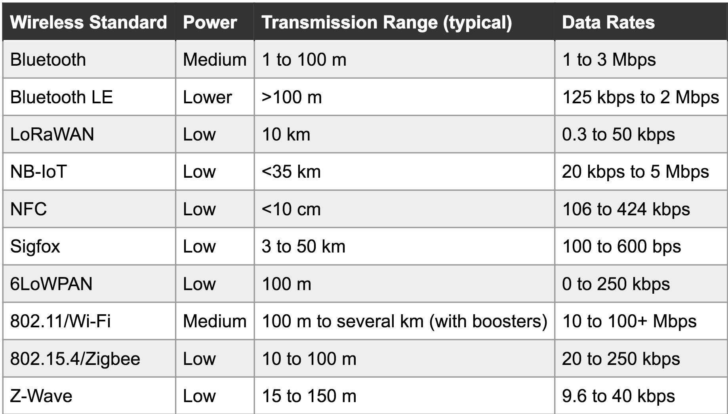
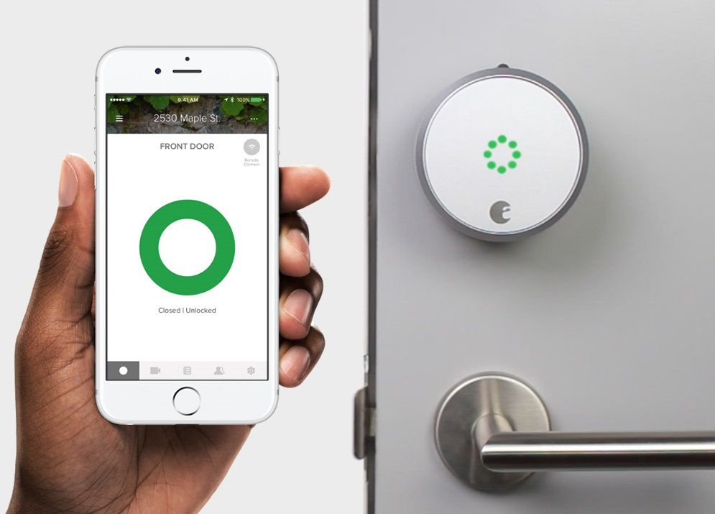
Smart Locks
Wireless Communication Protocol:
WiFi (winner so far), Bluetooth, Zigbee, NFC, …

Slide 3
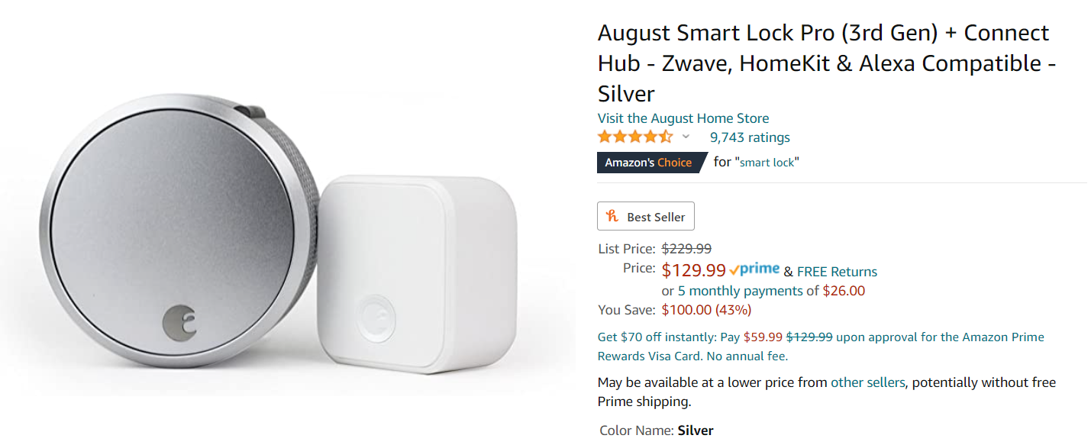
Let’s see what the market likes☺

Slide 4
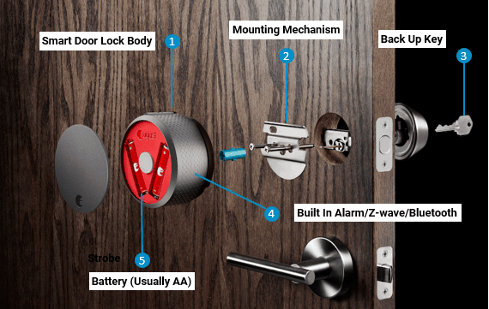

Slide 5
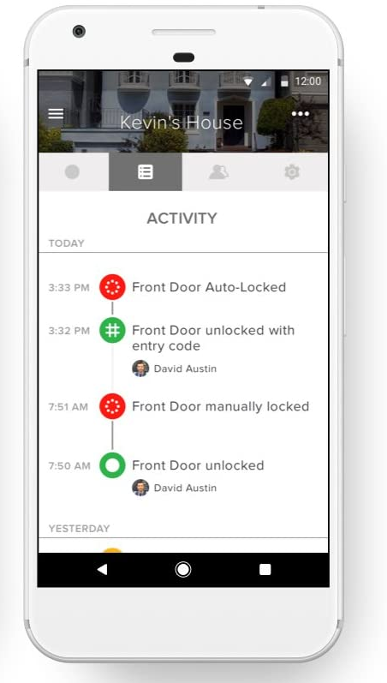
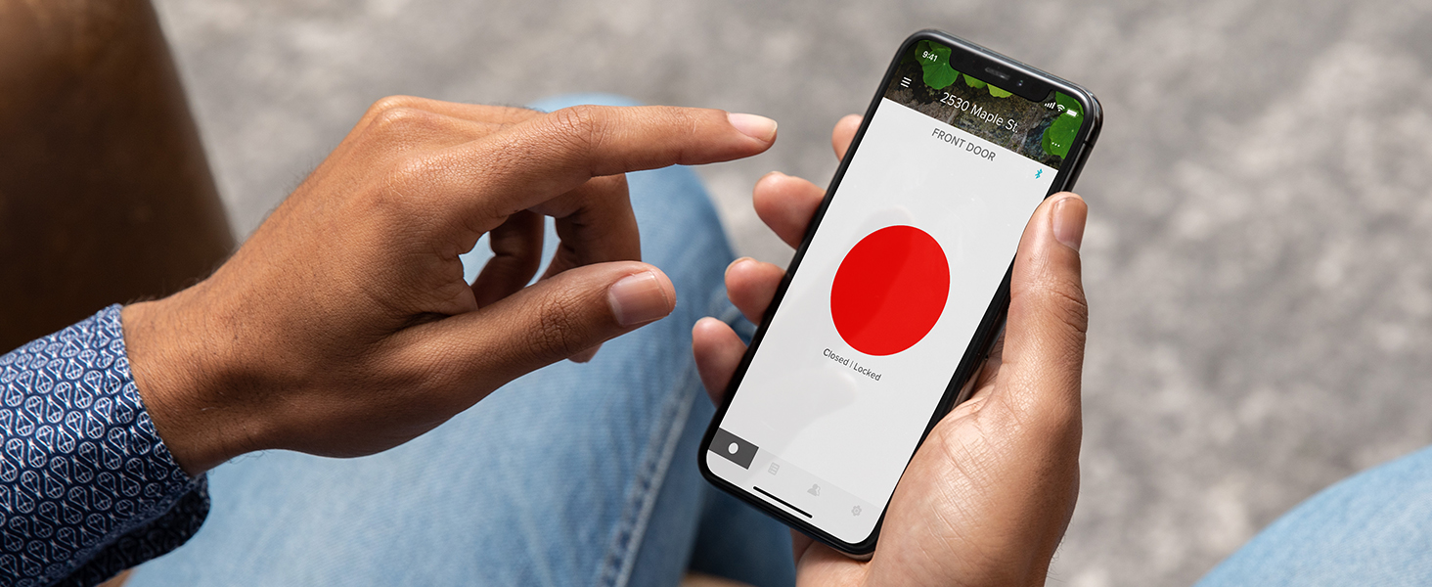
Their Design Features
Wireless requirements - 2.4GHertz Wi-Fi network (and BLE)
Work on 4 AA Batteries
Lock and unlock your door, keyless access all from your phone
Always know who is coming and going. Track activity

Slide 6
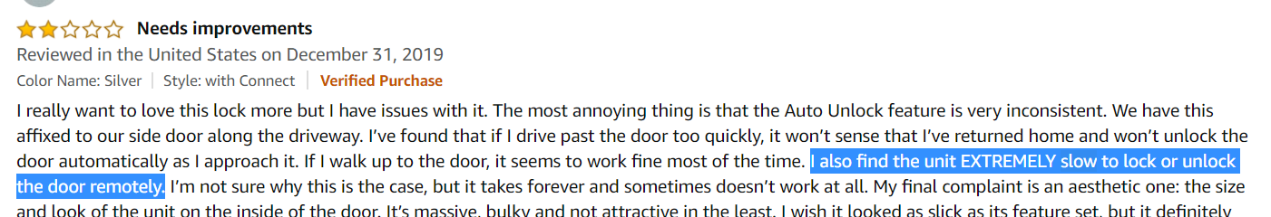
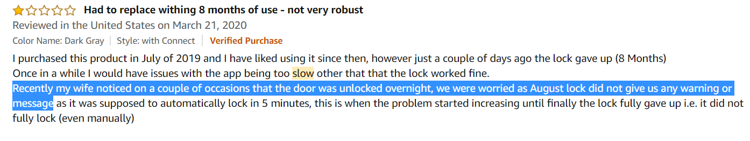
Major Complains
1) latency:
2) Reliability:
3) Consistency:
Notes:
Of course it has a lot of positive feedbacks. But let’s focus on the complains.
What is latency? Network concept, RTT?
What is the difference between reliability and consistency? Reliability means you send a command, and it should be executed correctly
Consistency means the status you know agrees with the status on the lock. Like if the door is unlocked, you should receive the status that the door is unlocked. You should’t know that the door is locked.
So again, every system may fail. If the you send a command to the door to lock it, improving reliability means to reduce the chance that the door fails to lock, while consistency means to keep you notified if it does fail.

Slide 7
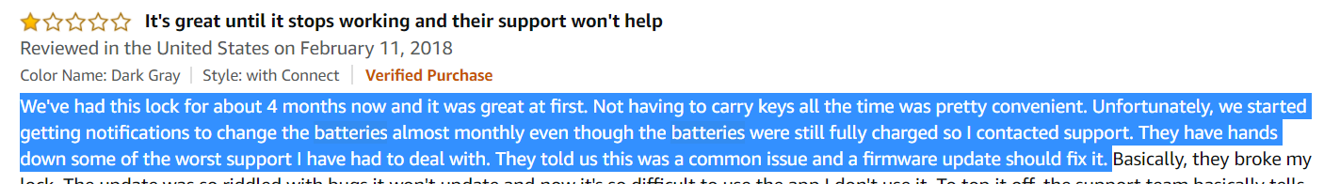
Feedbacks:
4) Energy Efficiency:

Slide 8
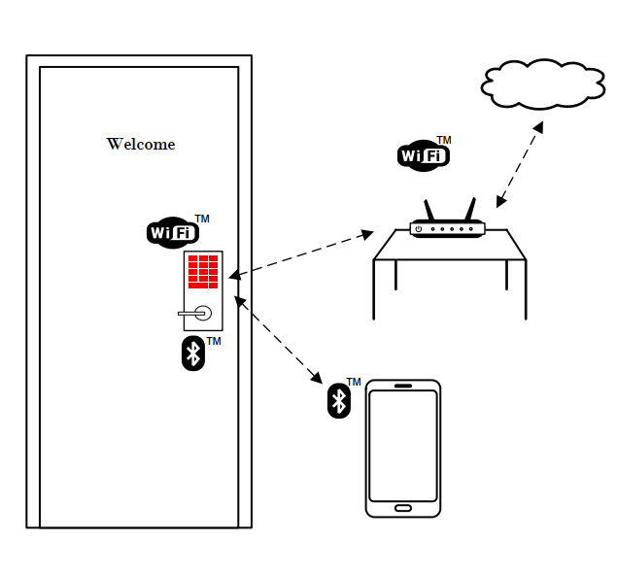
System Design
Two Communication Channels: WiFi & BLE
Two Operation Modes:
Phone communicates with cloud, cloud controls lock
Phone controls lock directly via BLE
Notes:
To understand the reasons for these negative feedbacks, we need to understand its system design.

Slide 9
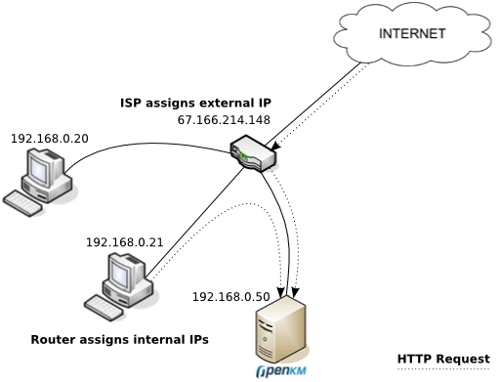
How does it work?
Lock
Cloud Server
Phone
Why we need both BLE and WiFi? --- WiFi can be slow…
Why WiFi can be slow?
https://www.hackster.io/hackershack/smartphone-connected-home-door-lock-69944f
https://www.youtube.com/watch?v=bAcK80fm1_0
Js code: https://github.com/HackerShackOfficial/Smartphone-Doorlock/blob/master/doorlock.js
Why we need a cloud server?
Impact on Performance:
Latency, energy, Reliability
Is it just a matter of tradeoff?
Notes:
WiFi is slow sometimes, hence we use both BLE and WiFi.
Why we need a cloud server? Your phone cannot directly access the lock, as the lock only has a private address.
Trade-offs: energy and latency… if we can tolerant longer latency, we can use polling. Send a request to the cloud server every 5 minutes, to check if any command is received.
But is that the only thing we can do?

Slide 10
Web of Things Integration Patterns
Cloud Integration Pattern
Direct integration Pattern
Gateway Integration Pattern

Slide 11
WoT Cloud Integration Pattern
Some device have access to the cloud.
Problem: sometimes the client and the device are close, but still need to go through a remote cloud.
Cloud
Pub/sub
Client
Device

Slide 12
WoT Direct Integration Pattern
Some device have full internet access.
Cloud
Client
Device
Typical use case: The device communicates with low latency to a local device like a phone.
Example: Use a phone to communicate via WiFi (with WiFi router) to an HTTP server
on a device. Use web sockets for publish/subscribe, e.g., phone listens for doorbell events.

Slide 13
WoT Gateway Integration Pattern
Cloud
Gateway Integration Pattern.
The interaction between the gateway and the device is hidden from the client.
Benefit:
predictable and consistent latency
no need to maintain connection in local area network
prevent privacy issues.
Local
Gateway
Client
Device
Notes:
Why privacy issues?

Slide 14
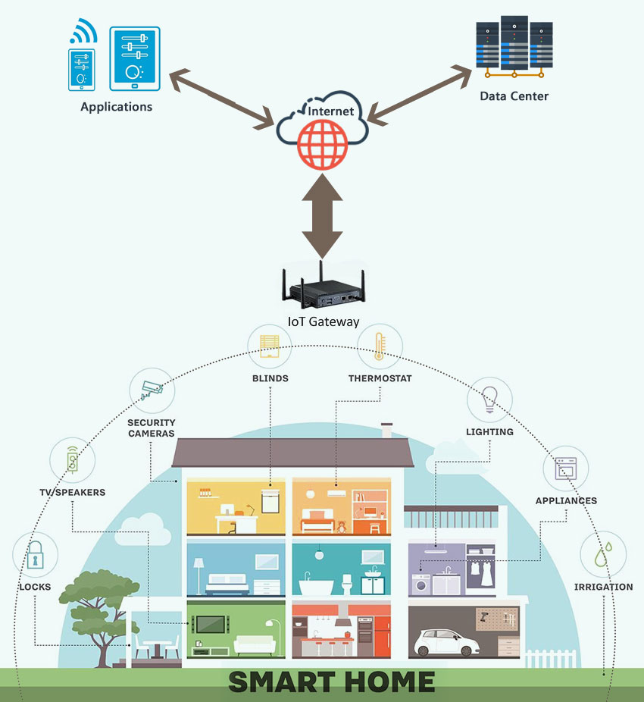
A typical smart home architecture:
Smart devices
Gateway
Applications

Slide 15
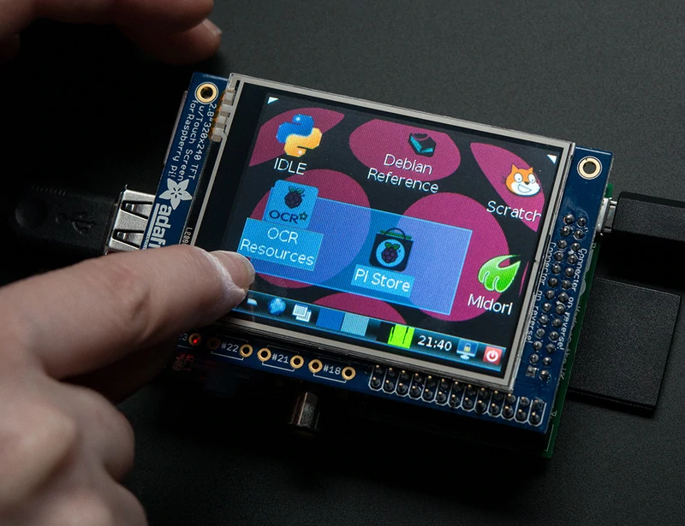
Raspberry Pi
Affordable credit-card sized computer
Plugs into a computer monitor or TV
Uses standard keyboard and mouse
Can browse the internet and play HD video
Can also interact with the outside world!

Slide 16
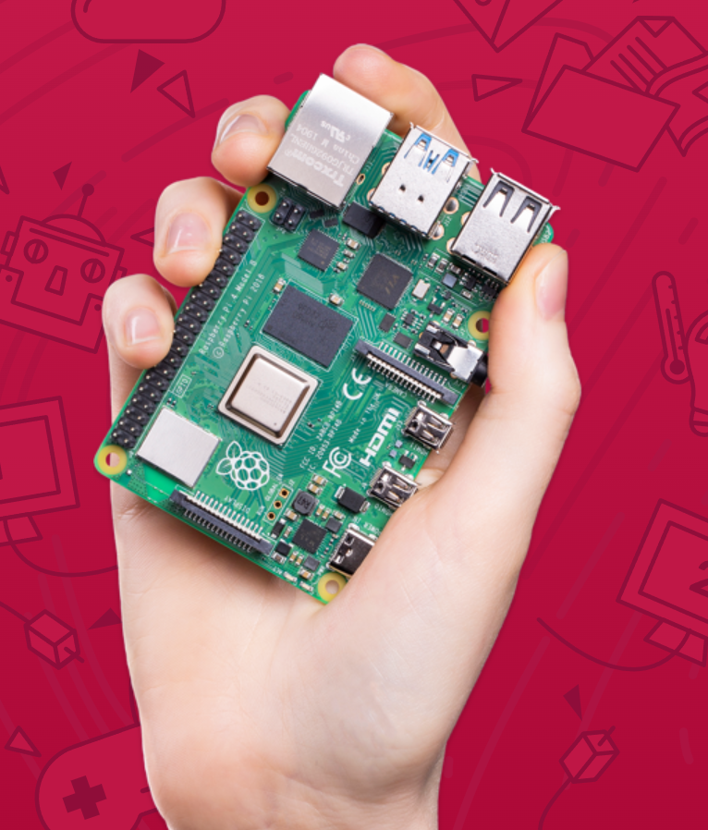
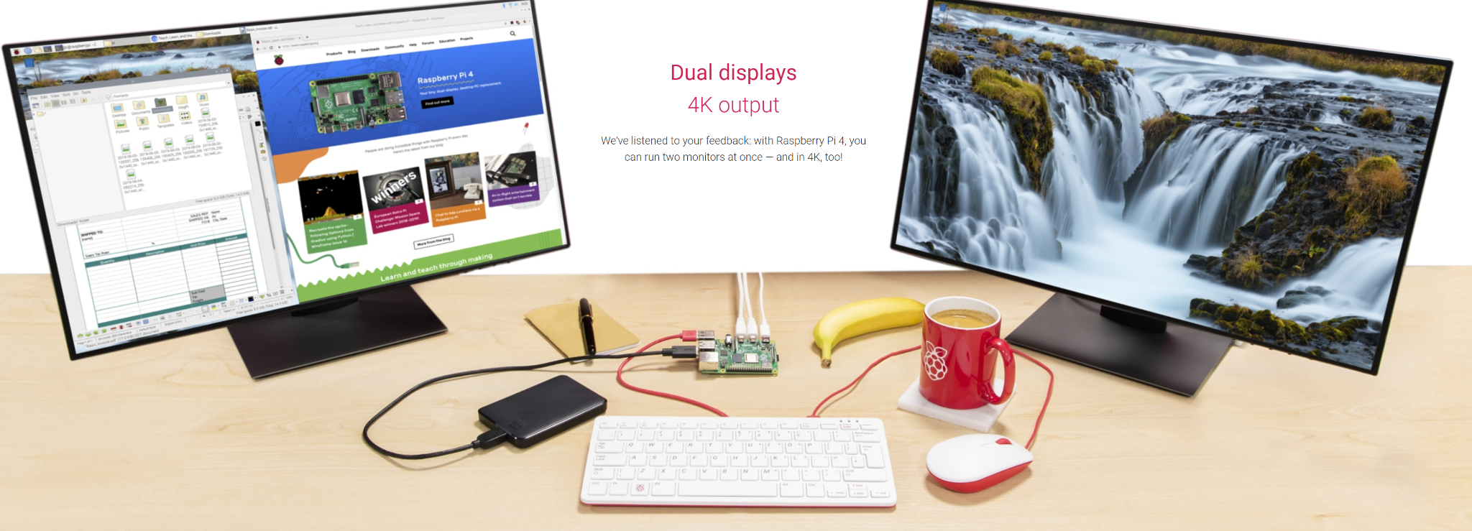
Models: Pi 4B
Broadcom BCM2711, Quad core Cortex-A72 (ARM v8) 64-bit SoC @ 1.5GHz
2GB, 4GB or 8GB LPDDR4-3200 SDRAM (depending on model)
2.4 GHz and 5.0 GHz IEEE 802.11ac wireless
Bluetooth 5.0, BLE Gigabit Ethernet
2 USB 3.0 ports; 2 USB 2.0 ports.
Raspberry Pi standard 40 pin GPIO header
2 × micro-HDMI ports (up to 4kp60 supported)
Vulkan 1.0 Micro-SD card slot
5V DC via USB-C connector
$40 - $100

Slide 17
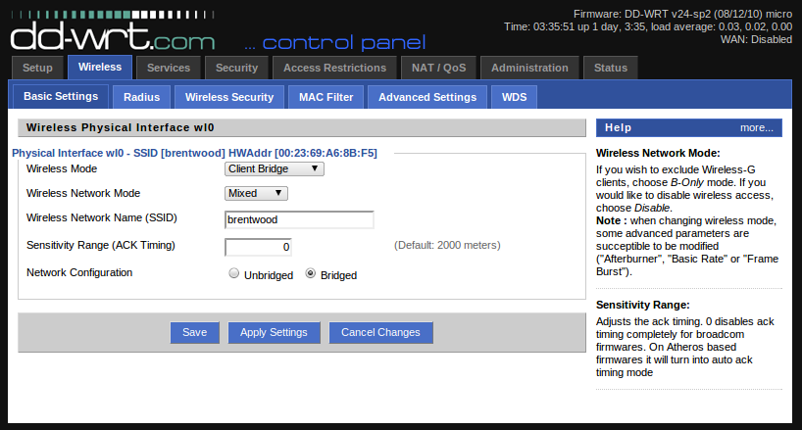
IoT Home Gateway
WiFi DD-WRT (firmware): linux-like system on routers
Make your home WiFi router programmable

Slide 18
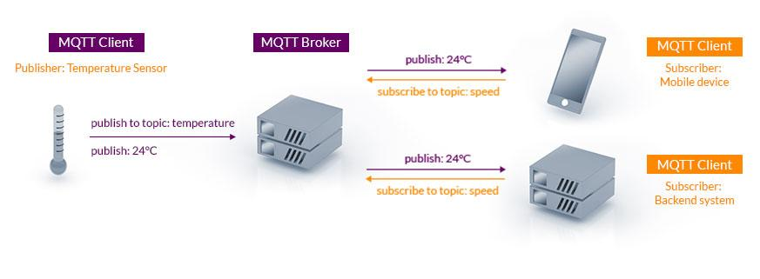
IoT Protocols
MQTT: Message Queuing Telemetry Transport
Publish, Subscribe (pub/sub)
Lightweight (based on TCP)
https://www.reddit.com/r/COVID.RSS
Notes:
tuh·leh·muh·tree

Slide 19
MQTT - Topic
A topic forms the namespace
Is hierarchical with each “sub topic” separated by a /
myhome/floor1/bedroom1/temp
A subscriber can subscribe to an absolute topic or can use wildcards:
/Dearborn/TestRd/123/event
Event in Apt 123, Test Rd, Dearborn
/Dearborn/TestRd/+/event
Events happens in all apts in TestRd in Dearborn
/Dearborn/TestRd/123/#
All information (event, alarm) in apt 123 TestRd, Dearborn

Slide 20
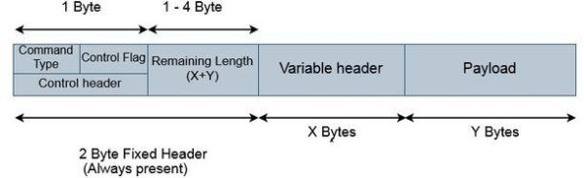
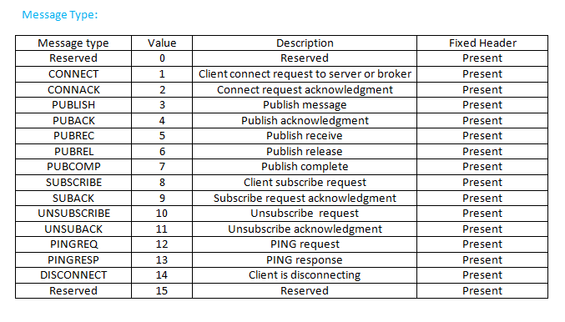
Use on Constrained Networks
Protocol compressed into bit-wise headers and variable length fields.
Potential privacy issue?

Slide 21
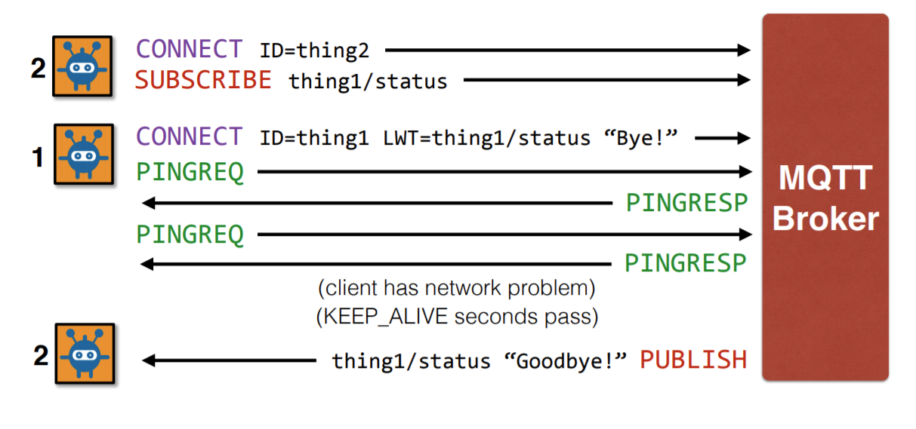
Use on Constrained Networks
“Last will and testament” (LWT): reliability

Slide 22
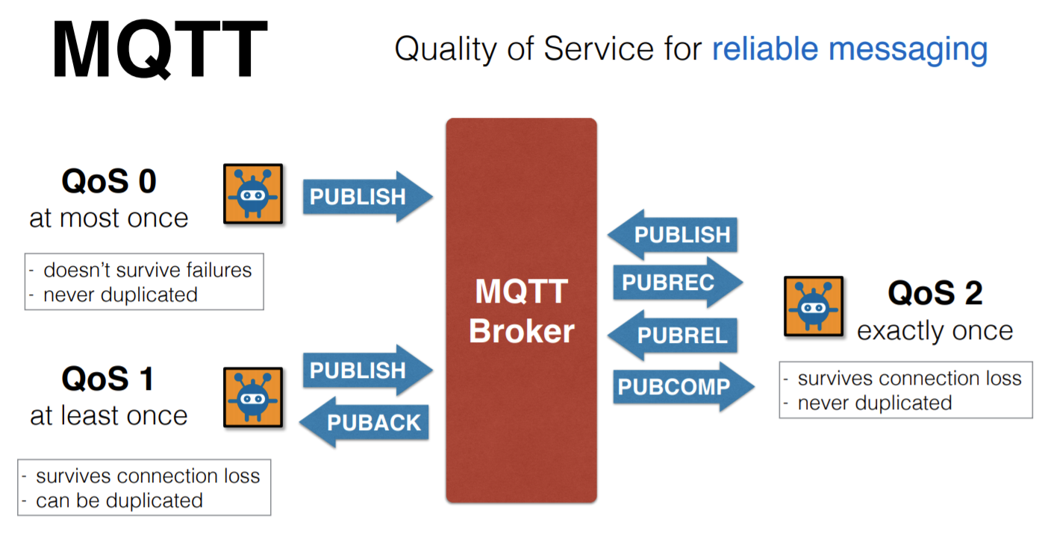
Use on Constrained Networks
Provides multiple message delivery options

Slide 23
MQTT for Request/Response
Asynchronous bidirectional “push” delivery of messages to applications (no polling)
1) Client
- subscribe topic "function-xyz/response/<id>" //note: <id> is a client unique ID
2) Server
- subscribe topic "function-xyz/request/+" //note: "+" is a wildcard
3) Client
- publish topic "function-xyz/request/<id>" payload <input parameter>
4) Server
- receive notification "function-xyz/request/<id>" payload <input parameter>
- retrieve <id> from string
- process function-xyz(<input parameter>)
- publish topic "function-xyz/response/<id> " payload "<response>"
5) Client
- receive notification "function-xyz/response/<id>" payload "<response>"

Slide 24
Try it for yourself?
Mosquitto： open source message broker that implements the MQTT protocol versions 5.
Test server:
2. Run mosquitto server on your own PC
Compared with http (on 3G network android)
93x faster throughput
11.89x less battery to send
8x less network overhead
mosquitto_sub -h test.mosquitto.org -t "hello/world" –v
mosquitto_pub -h test.mosquitto.org -t "hello/world" -m "Who's there"

Slide 25
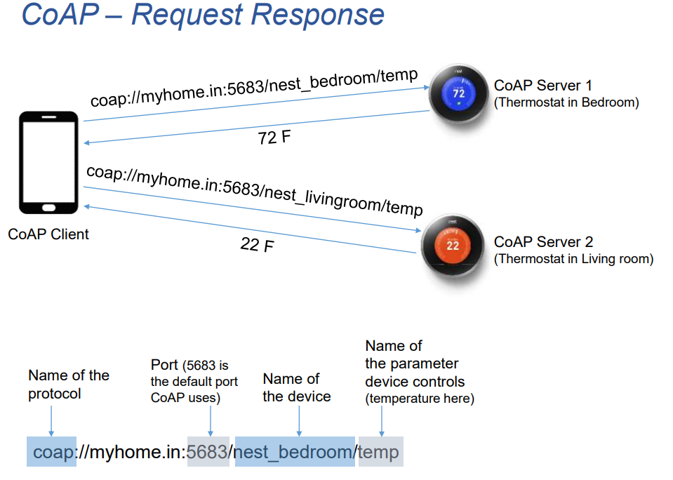
CoAP
Constrained application protocol
Lightweight HTTP (RESTful)
UDP with reliability enhancement:
Resource discovery

Slide 26
Light-weight HTTP
Same:
Request Methods: GET, POST, PUT, DELETE. (OBSERVE: subscribe to changes)
Response Methods: 2.xx (success), 4.xx (client error), 5.xx (servererror).
RESTful URI:
e.g., coap://homegateway:port/sensor/light
More information about RESTFUL: https://www.ibm.com/cloud/learn/rest-apis

Slide 27
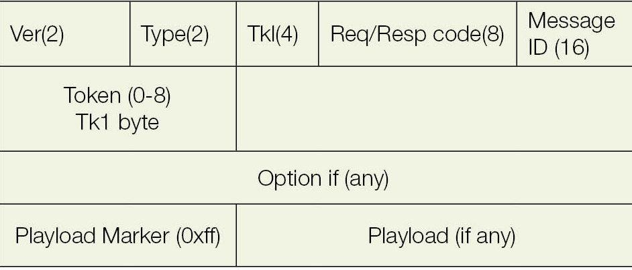
Light-weight HTTP
Different:
Binary header:
HTTP, text-based
Request / Response share the same ID (like DNS)
https://tools.ietf.org/html/rfc7252

Slide 28
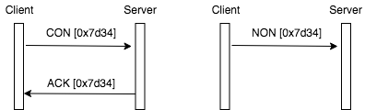
UDP-based
Message types:
Request: Confirmable, Non Confirmable,
Response: Acknowledgement and Reset
Example:

Slide 29
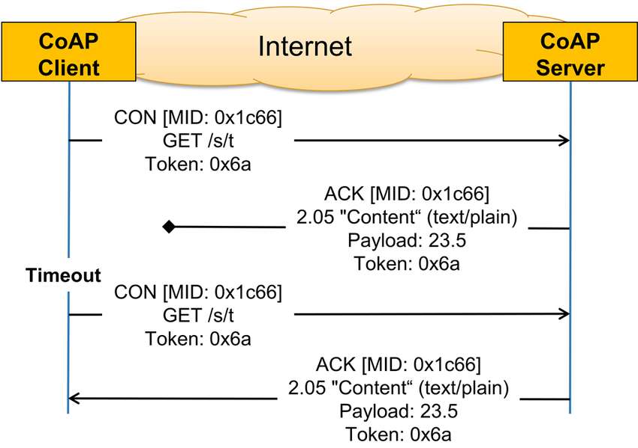
UDP-based Reliability Enhancement
Confirmable Message Upon Message Lost:

Slide 30
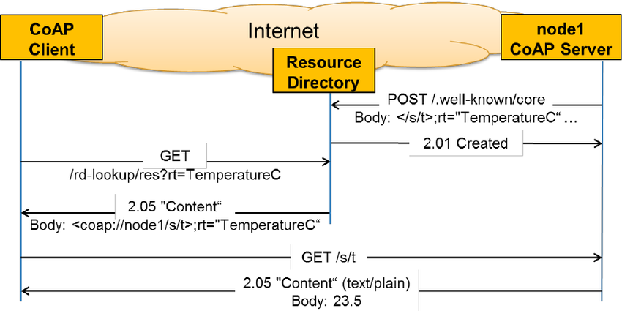
CoAP Resource Discovery
A well-known resource is used to discover other resources.

Slide 31
Design your own smart lock
General Design/Implementation Procedures:
System modelling (fixed)
Functional requirements (fixed)
Non-functional requirements
Security concerns (can be ignored now)
System/Communication Interface Design
Implementation Plan (who will do what)

Slide 32
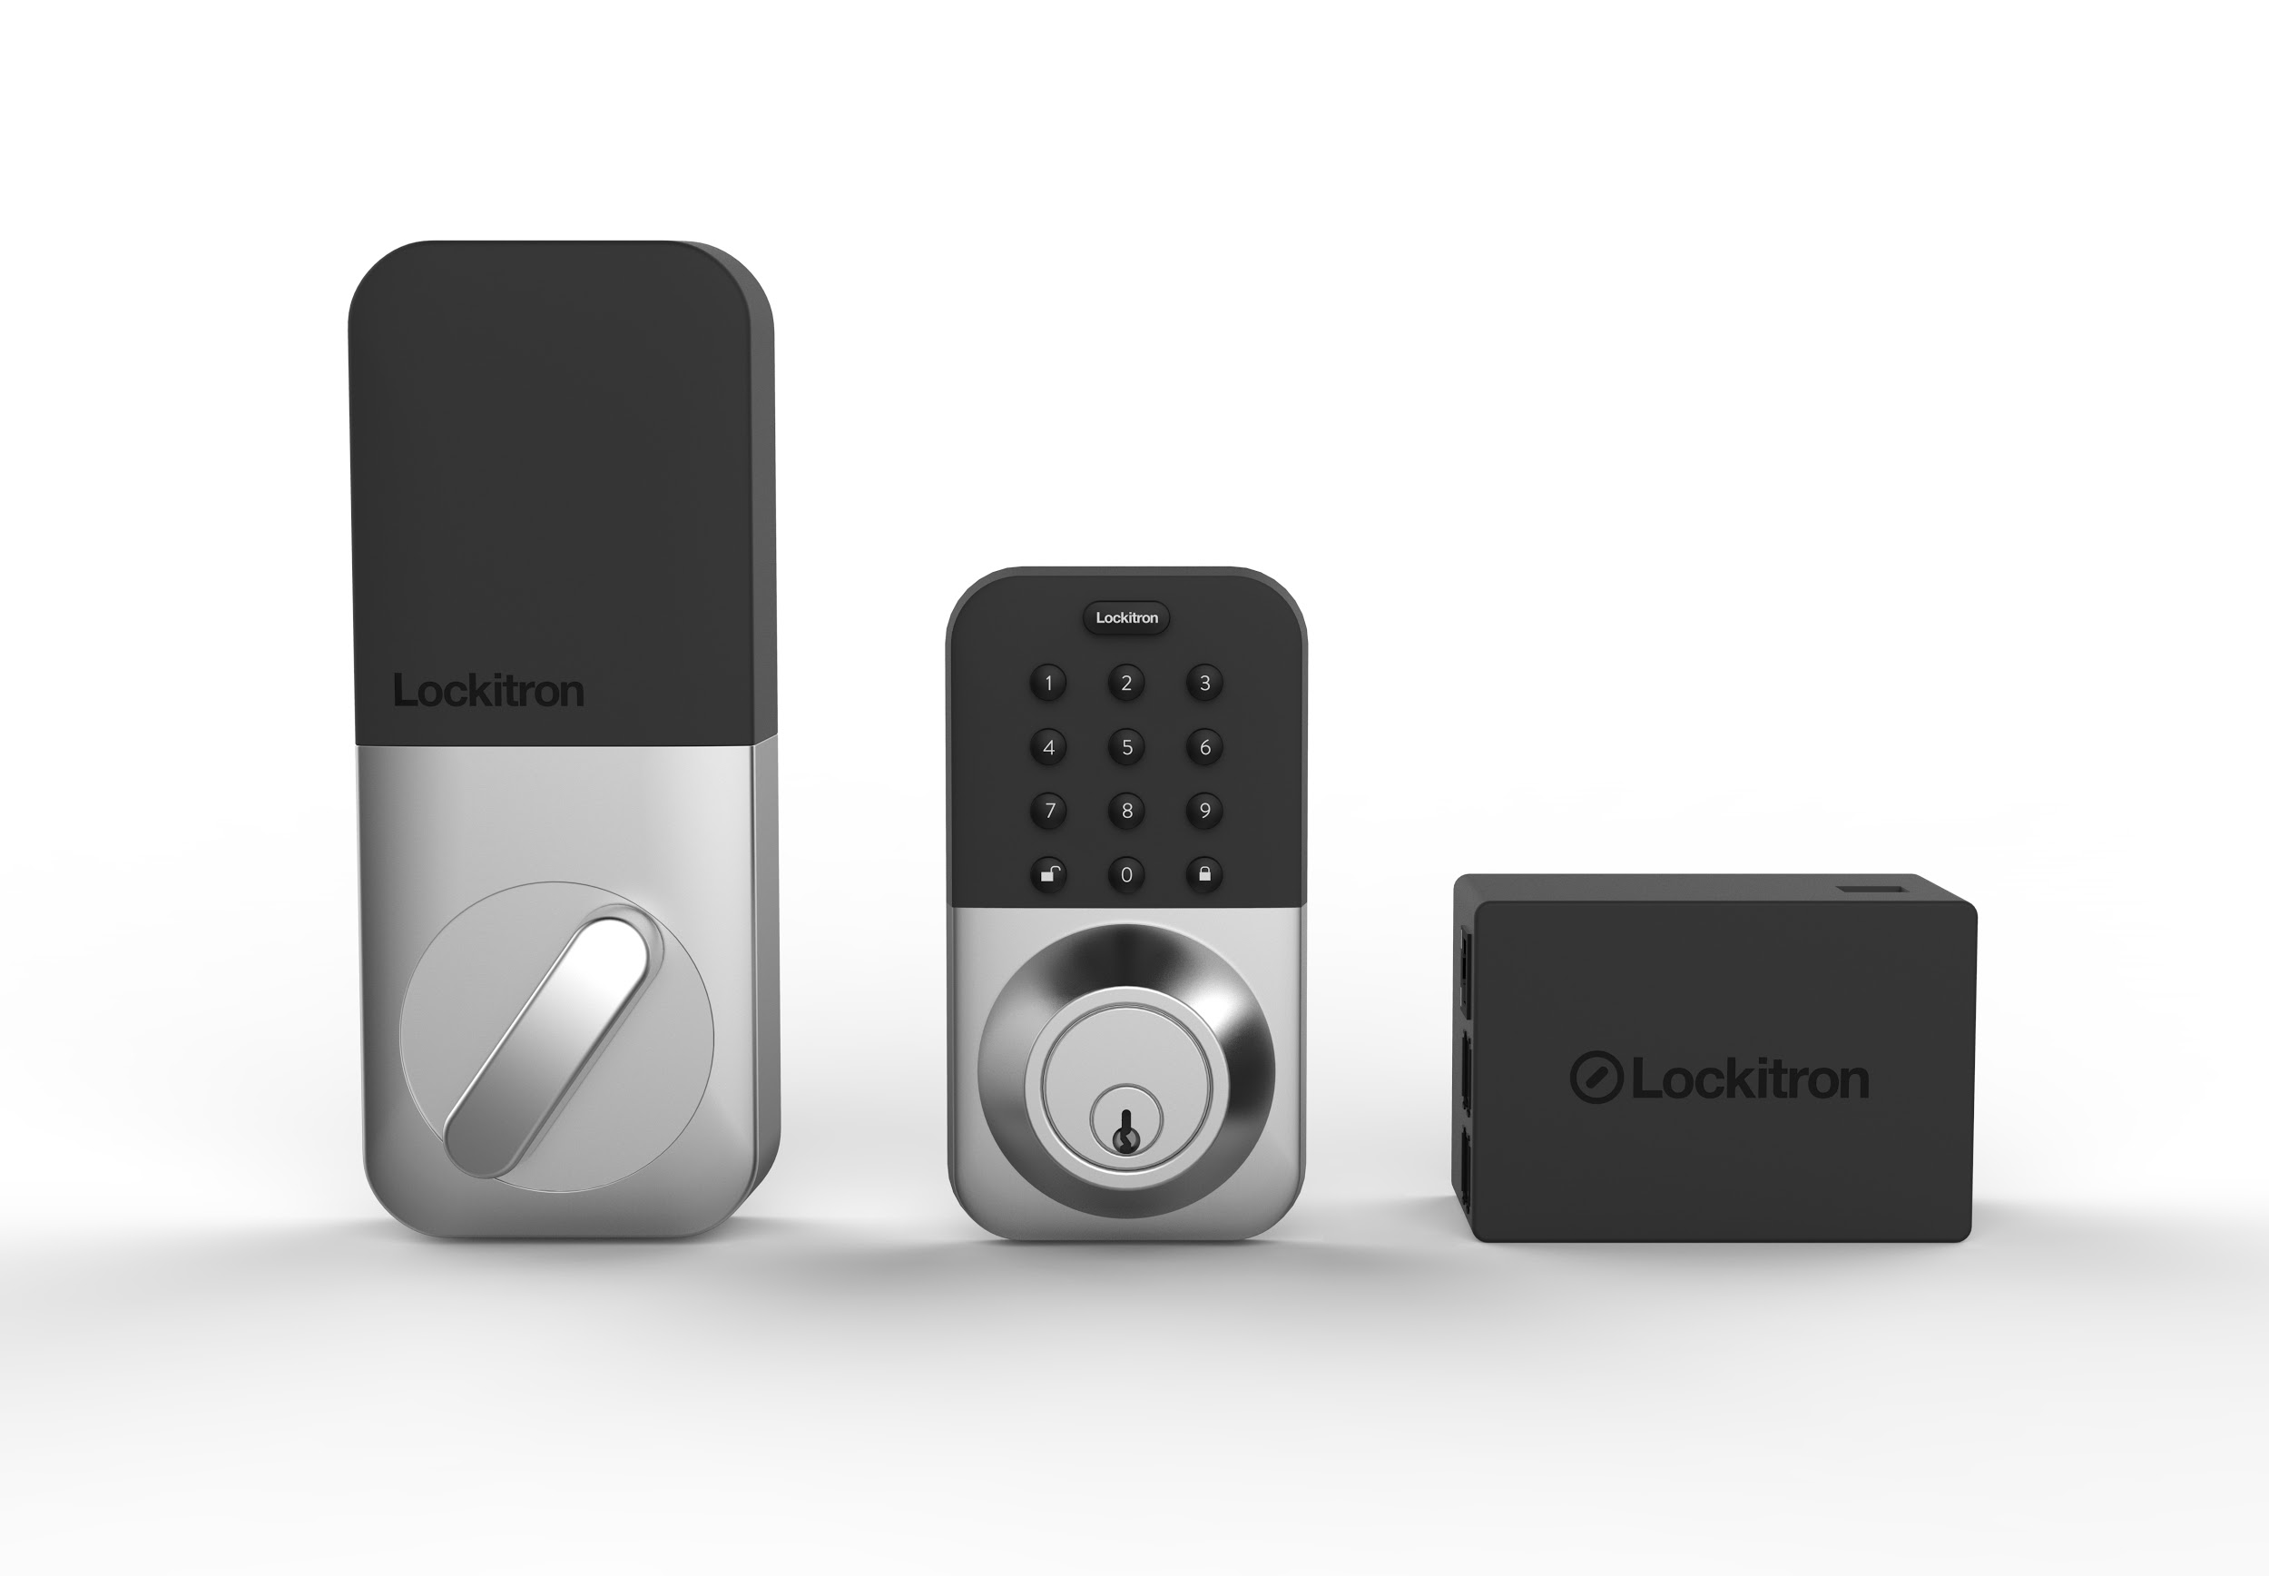
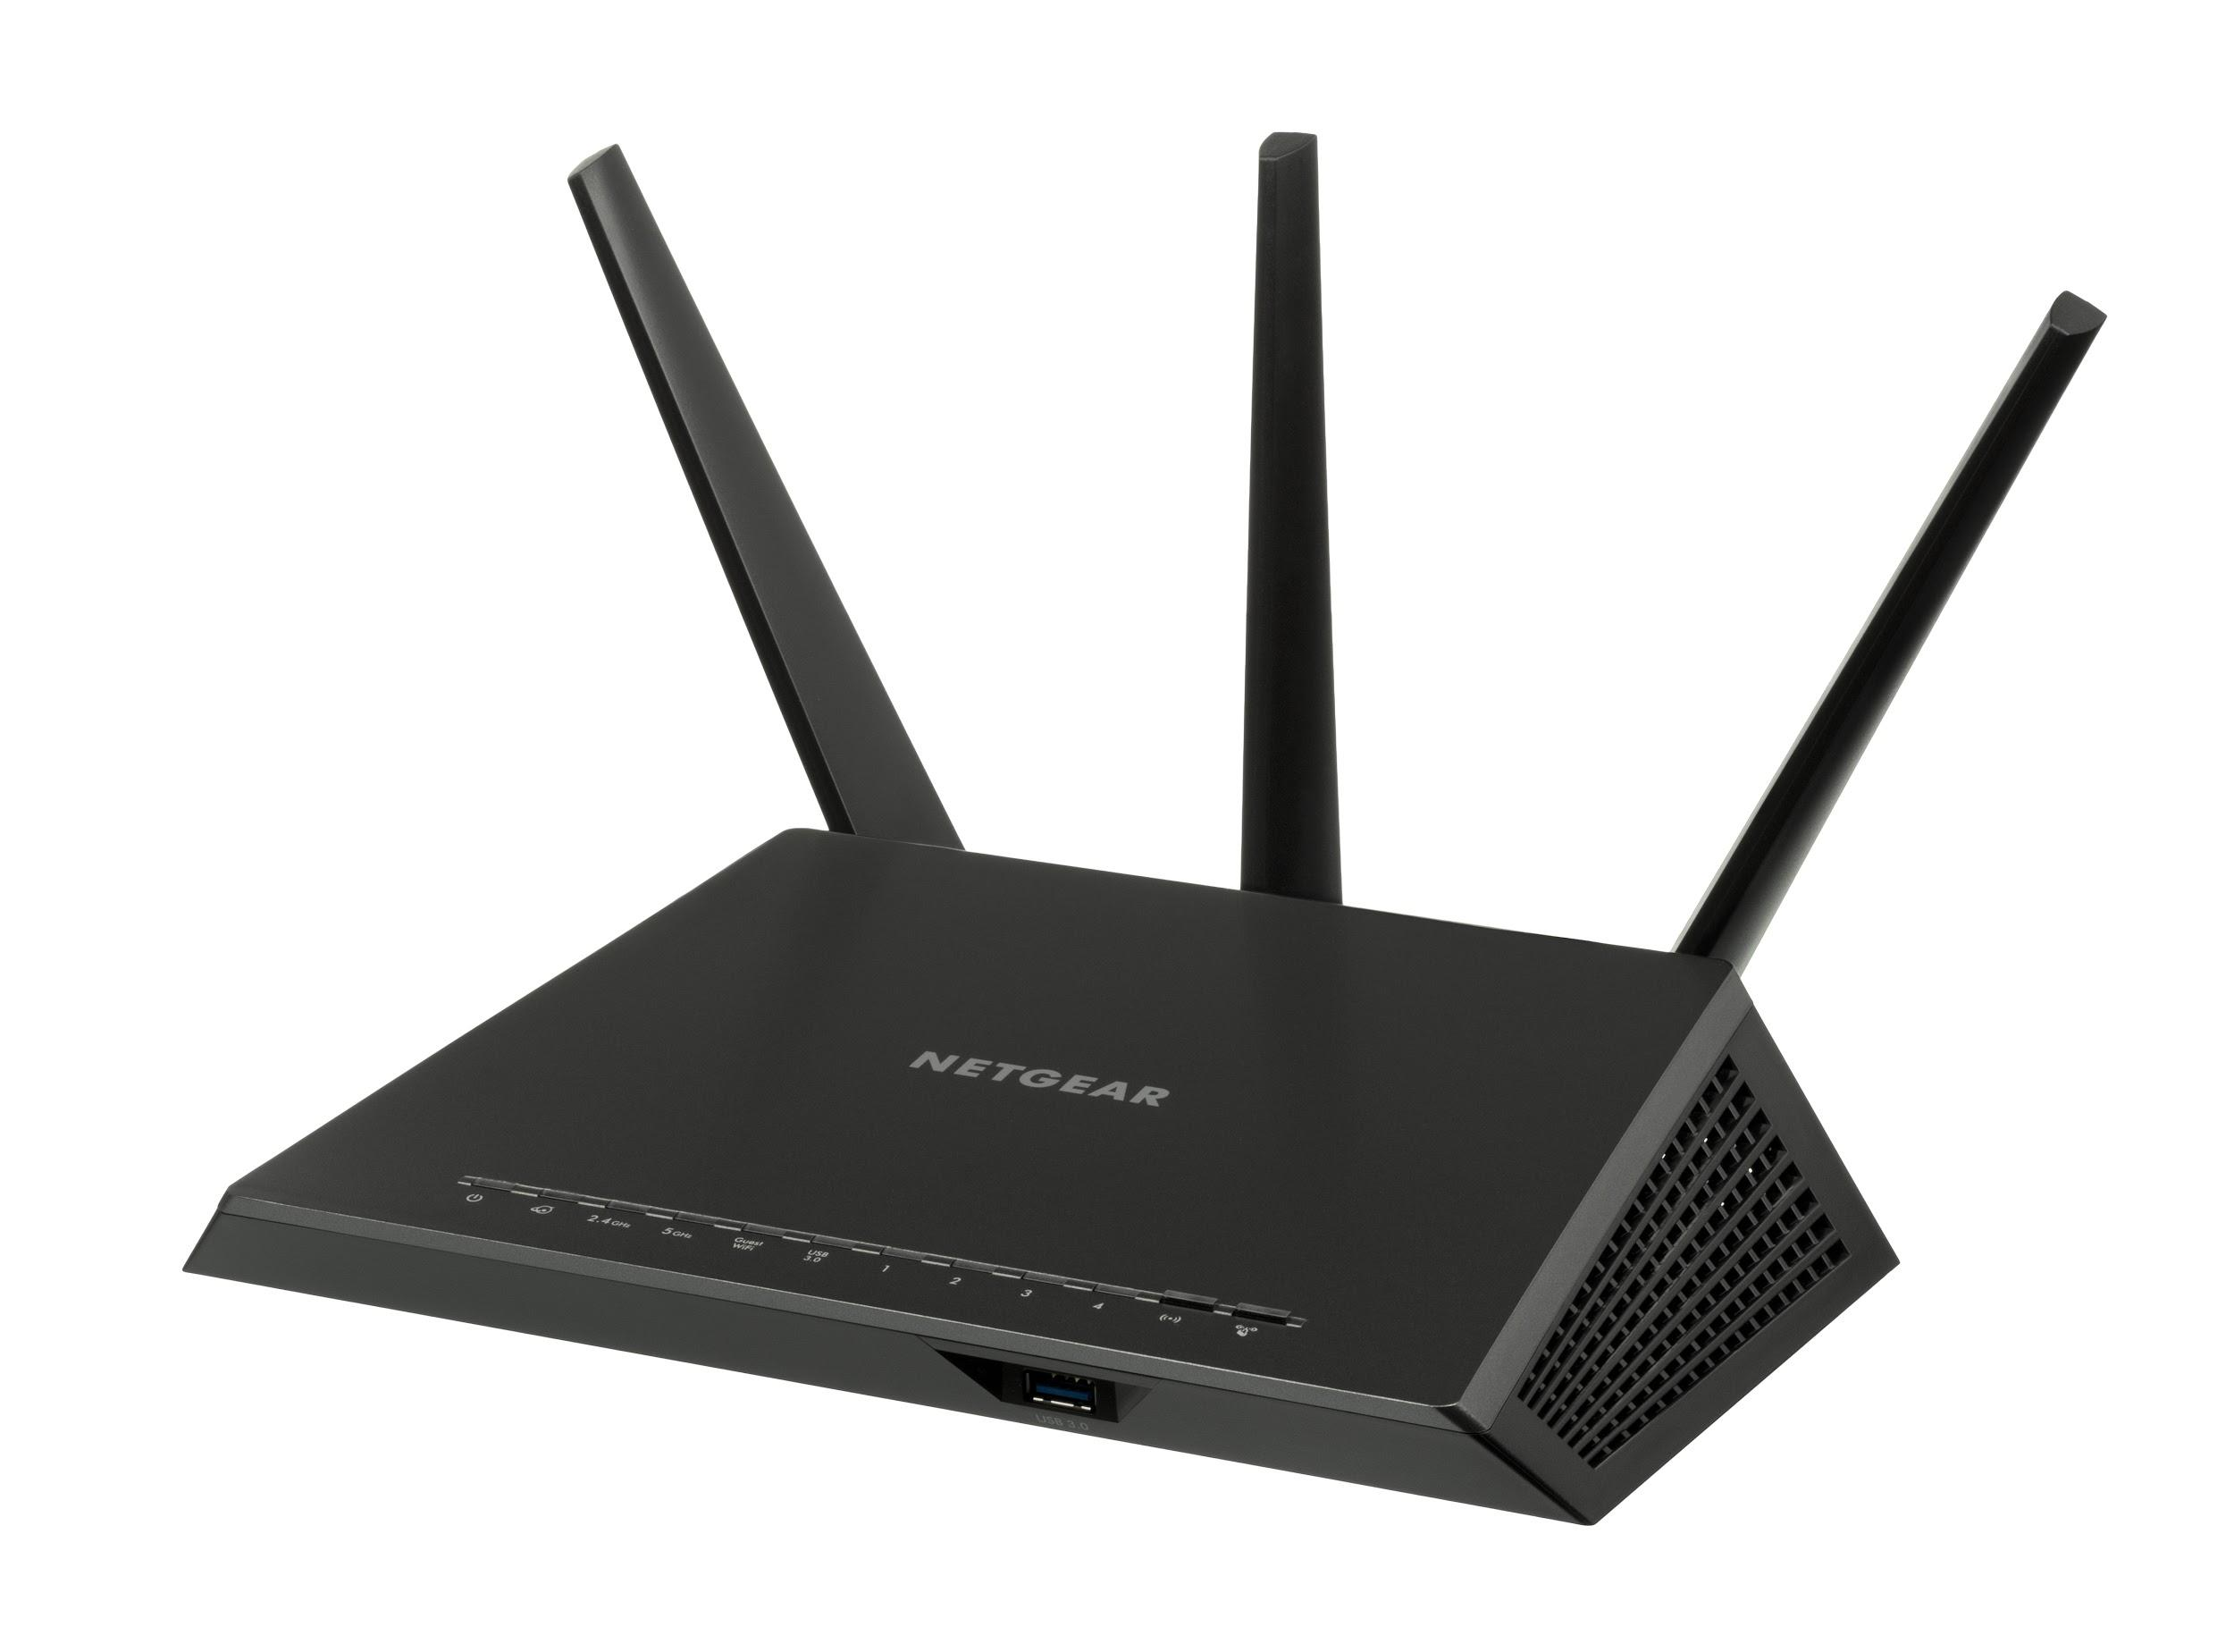
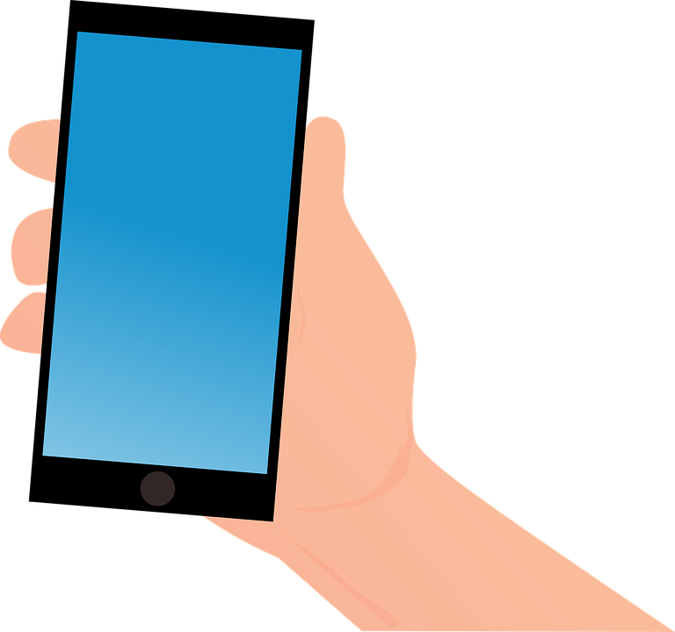
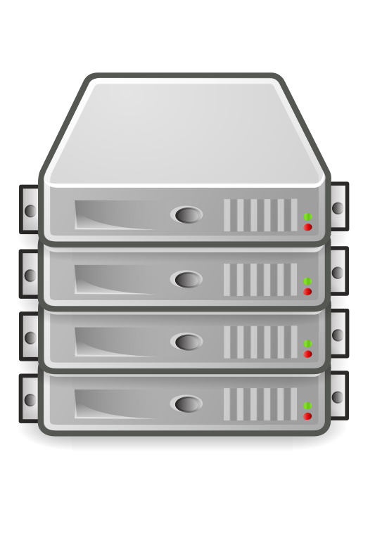
System Model
Assumptions:
No connection from outside phone to smart lock
All devices inside WiFi home network can communicate with each other.
A outside device can access the server inside the home wifi network. (how? ddwrt)
Home network (HN)
Smart Lock
Port Forwarding
Router
Client Inside HN
Home Gateway

Slide 33
Functions of the Lock
Register itself to the gateway and send heartbeats and operation logs.
Lock & unlock if given the correct password (permanent or temporary).
Activate or deactivate the temporary password (once used to unlock the door, the temporary password should be disabled automatically).
Send notifications if someone breaks the lock.
Return operation results and error messages.

Slide 34
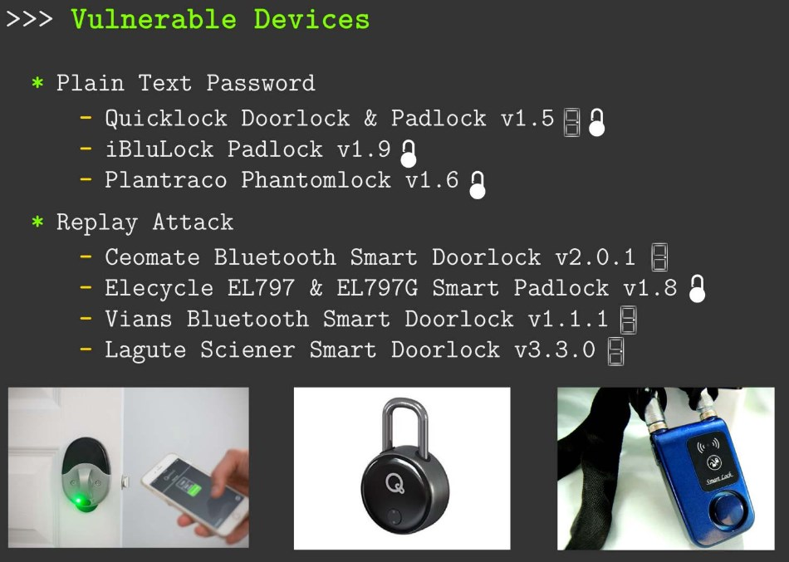
security Issues:
https://published-prd.lanyonevents.com/published/rsaus17/sessionsFiles/4479/SBX2-R2-All-Your-Locks-are-BLEong-to-US.pdf

Slide 35
NFR Example
Function 1: lock & unlock upon receiving the correct password.
Communication flow:
Client sends the request to the home gateway;
Home gateway controls the smart lock
Home gateway sends operation result back to the client.
Home network (HN)
Non-functional requirement:
Low Latency: 30ms
High Reliability: confirmable
Cost efficiency: avoid keep-alive messages
Smart Lock
b
Port Forwarding
Router
Client Inside HN
c
a
Home Gateway

Slide 36
NFR Example
Function 2: Heartbeat
Communication Flow:
Smart locks send periodical heartbeats to home gateway
a client can send request to check heartbeats
a client will receive notifications when the the gateway doesn’t receive normal heartbeat (miss n HBs in a row) from the smart locks.
Non-functional requirement:
Send HB every 5 minutes;
Reliability: m% (how m impact n?)
Home network (HN)
Smart Lock
1
Port Forwarding
Router
Client Inside HN
2
Home Gateway
Notes:
Let’s see we w

Slide 37
System Design Example
gateway:
HTTP Server to mobile clients:
coAP client: lock/unlock
CoAP server: discover IoT resources/collect heartbeat
Home network (HN)
Smart Lock
Port Forwarding
Router
Client Inside HN
Home Gateway

Slide 38
System Design Example
2. Smart Lock:
CoAP Server for lock/unlock
coAP Client for heartbeats
Home network (HN)
Smart Lock
Port Forwarding
Router
Client Inside HN
Home Gateway

Slide 39
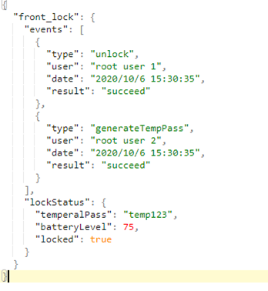
Interface Design Example
HTTP Server on Home Gateway
Restful Interface for mobile clients:
Get http://homeIP/front_door_lock/status?password=test
PUT http://homeIP /front_door_lock/lock?password=test
Response:
Operation result: Json formation (see right figure)
This is not secure!!!

Slide 40
Tips:
You can choose to implement necessary parts of your design, not all of them.
This is a networking course! Focus on how your communication procedure impacts the system’s performance! Keep your report within 3 pages.
Divide the workload:
Deliver on time: one video presentation required for CP5.
Everyone has reasonable contribution: individual reports required for CP5.
Exploration project. If you are interested in exploring some possibilities, contact the instructor

Slide 41
If not clear, see what others are doing…
August wifi smart lock:
https://august.com/pages/how-it-works
Video: https://www.youtube.com/watch?v=42znpiPWnl8
https://www.home-assistant.io/integrations/lock.mqtt/
https://github.com/aharshac/smart-lock
https://github.com/maximemoreillon/lock
https://github.com/CESARBR/knot-cloud-websocket
COAP example

Slide 42
Previous Teams’ results (Fall 2020) https://www.youtube.com/watch?v=fXbI1aAPssw https://www.youtube.com/watch?v=R7uNEh3DEWY

Slide 43
Edge Computing
CIS 490 H/590J (Win 2023)
Project-oriented or Research Oriented
The course introduces state-of-the-art edge computing technologies and their applications in data-intensive distributed systems like smart homes, Internet of Things, and connected vehicles. Topics include edge computing applications and platforms, edge-based sensor data collection and processing, computation offloading and QoS-optimal task scheduling, and security/privacy. This course will also explore the current challenges facing edge computing. Participation in a project is a requirement in this course.

Slide 44
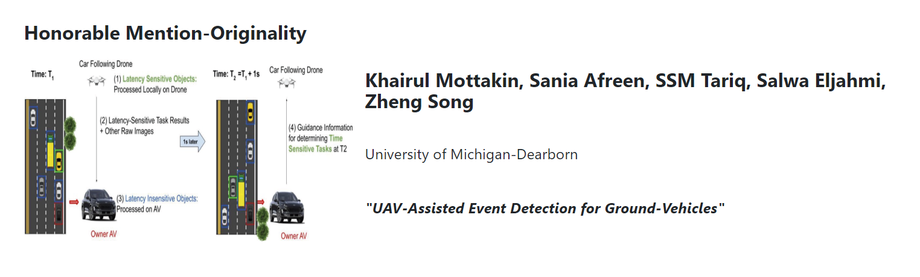
Student Design Competition on Networked Computing on the Edge (CPS-IoT Week, May 22)
https://smile-sdsu.github.io/cps_iot22/

Slide 45
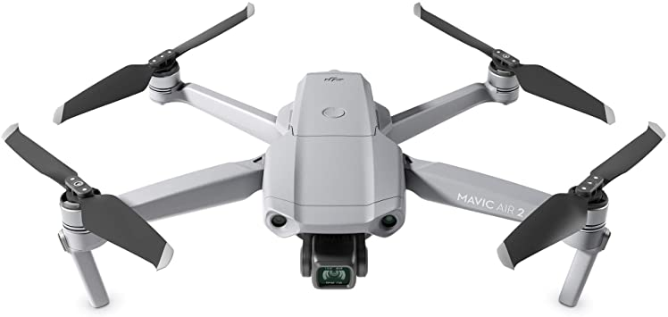
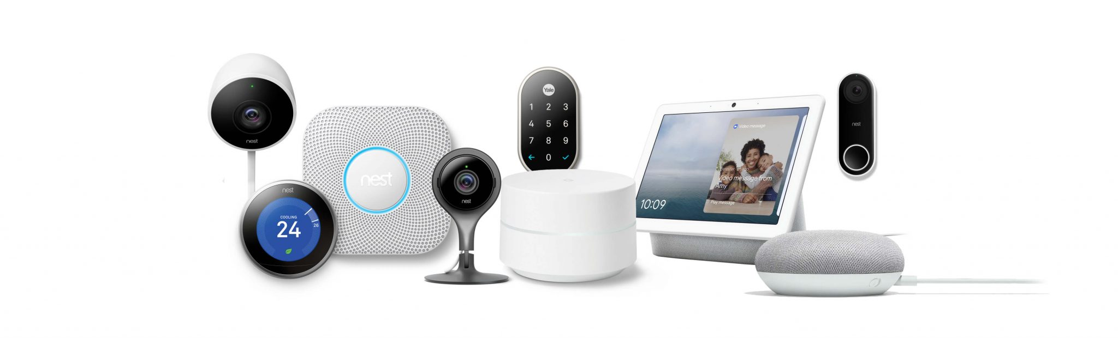
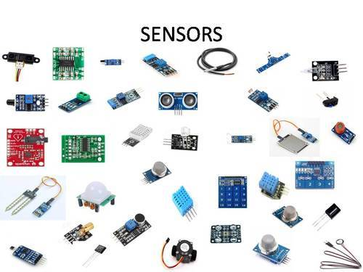
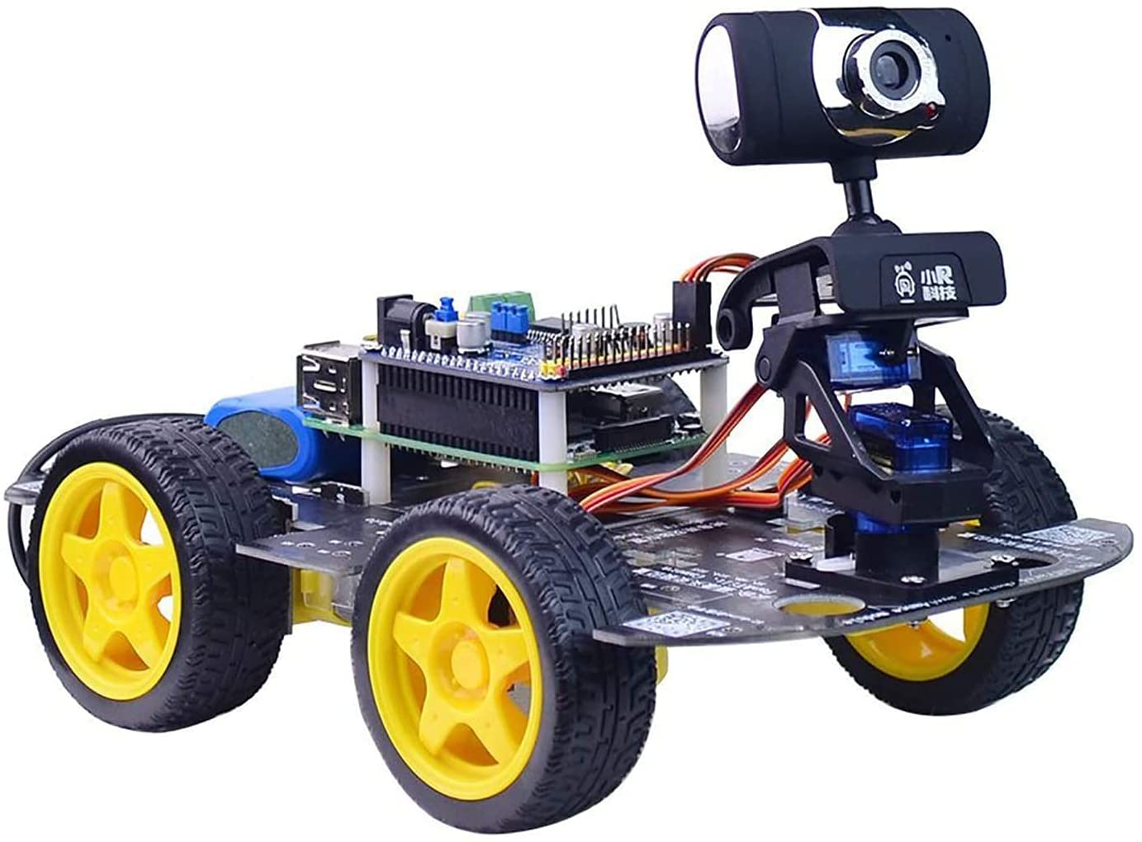
HW Devices
If you plan to take this course (in person), email me your device requirements

